Slide 1
Secular Stagnation vs. Productivity Slowdown
By: Jeremy Meng, Madeline Hanson

Slide 2
Overview
Advanced economies have observed slow economic growth, despite low policy rates ever since the financial crisis
Is this poor growth a or demand side problem?

Slide 3
Secular Stagnation
Definitions:
Demand to invest is so low that it is insufficient to absorb savings in the economy (Hansen, 1939)
“Negative real interest rates are needed to equate savings and investment” (Teulings and Baldwin, 2014)

Slide 4
Factors Increasing Supply of Savings
Post-crisis risk aversion:
Capital and collateral requirements
Increased cost of financial intermediation

Slide 5
Factors Increasing Supply of Savings
Increased savings in EMEs
Source: World Bank

Slide 6
Factors Increasing Supply of Savings
Growing income inequality
Source: World Bank

Slide 7
Factors Decreasing Demand for Investment
Lower population growth rates
Source: World Bank

Slide 8
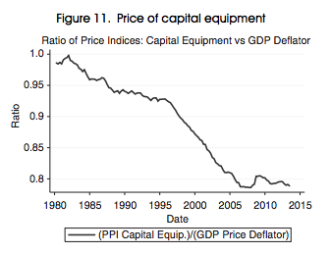
Factors Decreasing Demand for Investment
Lower costs of capital
Source: Summers, 2014

Slide 9
Implications
Financial instability
Limited monetary policy effectiveness

Slide 10
Addressing Secular Stagnation
We need to increase aggregate demand. This can be done through:
Fiscal policy
Promoting business confidence
Increasing access to private investment
Reducing income inequality

Slide 11
Supply side view: low potential output growth!
Productivity growth
AS effect: output per capita growth
Slower growth in capital to maintain capital-output ratio
Lower net investment
AD effect: demand

Slide 12
Q: Why is output growth is so low today?
A:
Diminishing return from digital electronic revolution (TFP Labor Productivity )

Slide 13
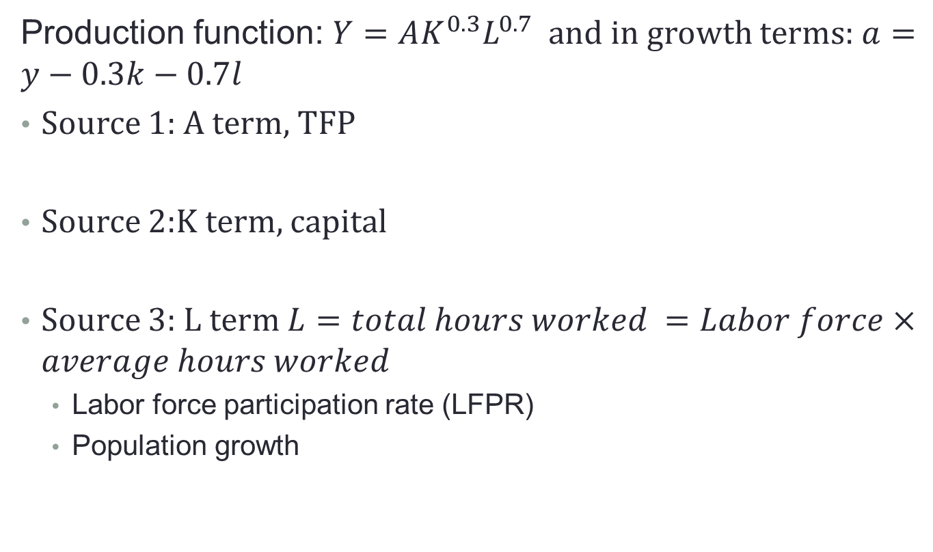
Theoretical view: sources of prod’ty slowing downing
Production function: $Y=AK^{0.3}L^{0.7}$ and in growth terms: $a=y−0.3k−0.7l$
Source 1: A term, TFP
Source 2:K term, capital
Source 3: L term $L=total hours worked =Labor force×average hours worked$
Labor force participation rate (LFPR)
Population growth

Slide 14
Three industrial revolutions
IR #1
1770-1840, has impact until 1900
Revolution of steam engine
IR#2
1870-1920, has impact until 1970
Revolution of electricity, internal combustion engine, organic chemistry, and medicine
IR#3
1960
information technology: PC, internet

Slide 15
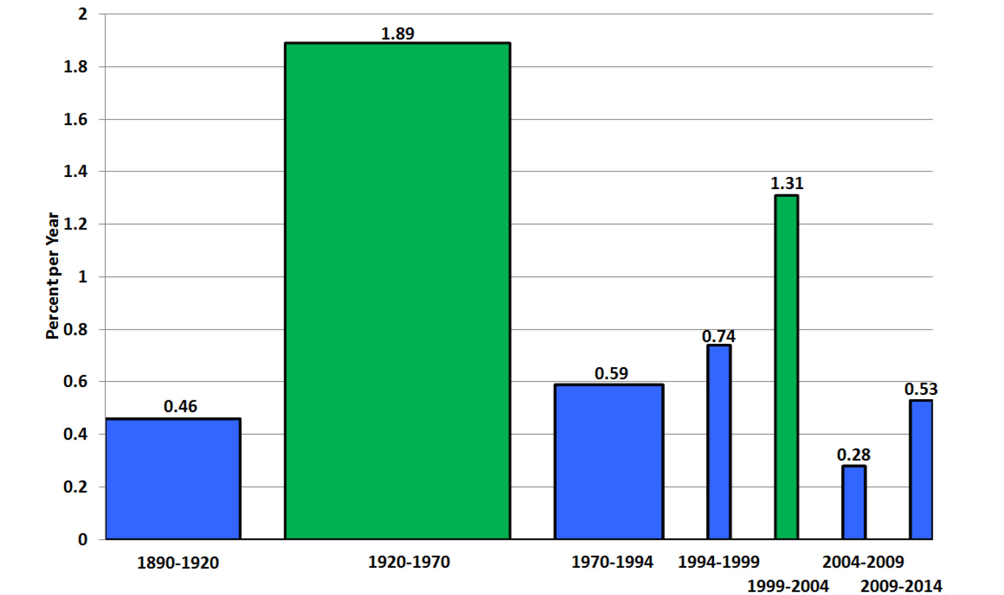
Evidence 1: Diminishing return of IR#1&2
U.S. TFP
IR#2
IR#3
Source: Gordon 2014

Slide 16
Evidence 2: IR #3 impacts only for a decade
Source: US: Gordon 2014; CA: Author’s calculation
Note: 2005-2013 excludes 2008 and 2009

Slide 17
Evidence 3: Contribution to GDP from ICT MFG disappears
Source: Author’s calculation

Slide 18
Counter evidence 1: measurement of K
Issue: flow and stocks of fixed non-residential capital vs Fixed capital-building, machinery, and equipment
Counter evidence 2: actual and potential TFP
Interaction between supply and demand side
Productivity growth
Productivity growth
vs
Lower net investment
Lower net investment

Slide 19
Q:Supply or demand side Problem?
A: uncertain the real cause
Luckily,
Living standard in Canada is improving
Productivity identity: $\frac{Y}{N}≡\frac{Y}{H}×\frac{H}{N}$ y growth $>$ population growth
Due to the immigration of high skilled workers, Canada escapes the decline of the labor
Source: US: Gordon 2014; CA: Author’s calculation
Note: 2005-2013 excludes 2008 and 2009

