Slide 1
European Sovereign Debt Crisis

Slide 2
Background
Triggered (in part) by the global recession, the Eurozone sovereign debt crisis broke out in late 2009
Several Eurozone governments unable to repay or refinance their debts
Several billion dollars in bailout packages from ECB and IMF later, many countries are still struggling
Growth forecasts are bad and expected to remain bad until the crisis is definitively resolved, high unemployment and debt, weak banks

Slide 3
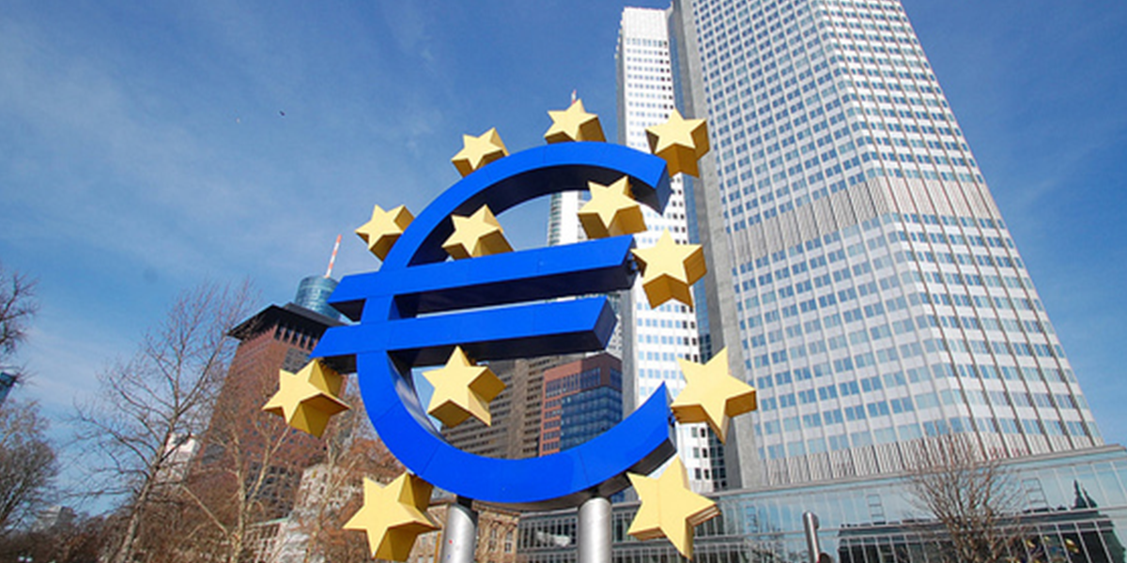
What Actually Happened?
Basic problem: many governments in the Eurozone (monetary union within the EU) ended up unable to deal with their debts → entered “debt spirals” with exploding interest rates and debt-to-GDP ratios, and failing banks
Debt spirals were triggered by the global recession but it was not the root cause
Crisis was the realization of structural imbalances in the setup of the Eurozone

Slide 4
Structure of the Eurozone Monetary Union
Maastricht Treaty 1991: Established the European Union, and the Eurozone monetary union - central banking system (European Central Bank: ECB) and common currency (the Euro) for member countries
Euro introduced in 2002
Monetary but not fiscal union: monetary policy is administered by the ECB and uniform across Eurozone countries
Setting of interest rates, maintaining price stability and guarding value of Euro
Fiscal policy is still at the discretion of member countries
Government revenue collection, tax policy, government expenditure

Slide 5
Should the Eurozone work?
Disconnect between control of monetary and fiscal policy might strike you as odd
Perhaps it should.
Maastricht included provisions on member economies to try to ensure stability, including the Stability and Growth Pact:
Debt-to-GDP ratio below 60%
Yearly budget deficits below 3%
Inflation below 1.5%
Were these enforced? No.
Broken several times including by France and Germany soon after Euro adoption in 2003

Slide 6
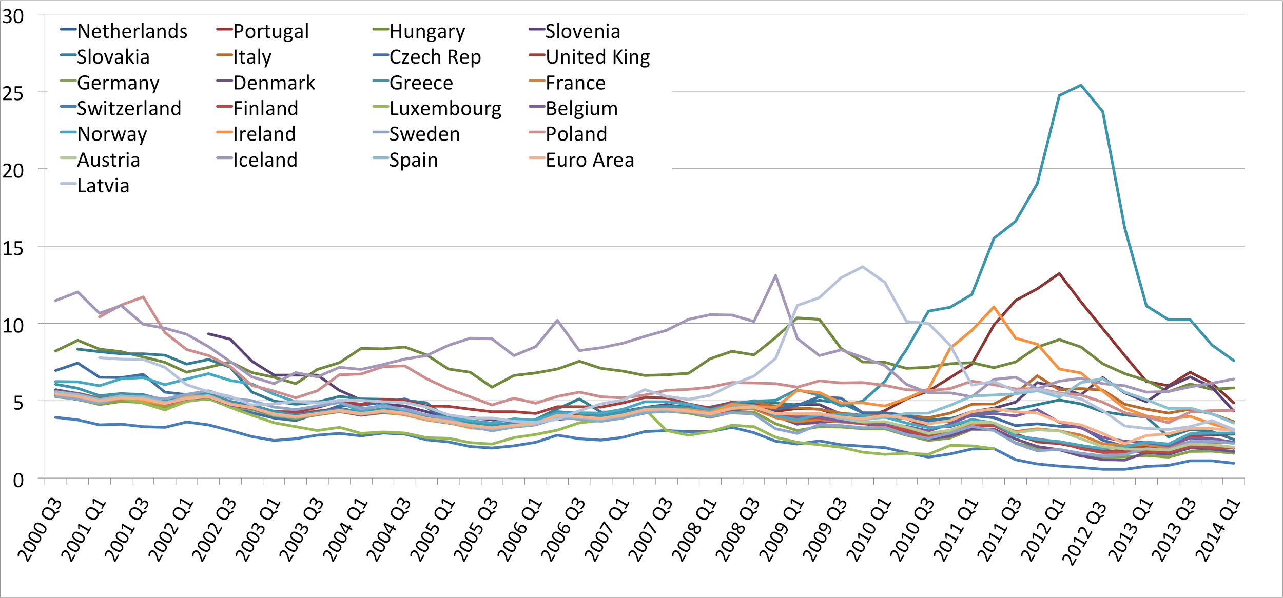

Slide 7
Groundwork of the Crisis
Exchange rates throughout Europe were turbulent in the early 1990s
Following Maastricht and the 2002 adoption of the Euro, interest rates in member countries converged, as they were expected to
This greatly reduced the cost of government borrowing for many of the “weaker” economies that had previously had to pay a higher premium on their debt
Markets believed Maastricht pledges of “no default, no devaluation, low inflation forever and for all”
Italy: cost of borrowing fell from 13% to 3% in a single decade - huge drop
Seemed like a good thing at the time, economic integration seemed to be effective

Slide 8
Groundwork of the Crisis
Problem: since the SGP criteria weren’t implemented, now just had more and cheaper borrowing from economies that were still structurally unstable and unreformed
All EZ countries got to borrow at German interest rates, but not all were as sound investments → interest rates were not reflecting real risk of lending to these countries

Slide 9
Not Really A Problem: Public Debts
Fact: this was not actually a “sovereign debt” crisis
There was massive public debt accumulation by some countries between the adoption of Euro and beginning of crisis
But over all, Eurozone cumulative debt-to-GDP ratio fell from 72% in 1999 to 66% in 2007
The countries with the highest debt-to-GDP ratios were not always the countries that ended up in trouble.
Ireland and Spain, at 24% and 36%, both had debt levels below the Maastricht-mandated 60% of GDP prior to crisis
Germany and France had high debt-to-GDP levels approaching the 60% ceiling
Clearly, debt levels alone were not the root of the problem.

Slide 10
The Real Problem: Current Accounts
The countries that ended up in the most trouble weren’t those with the most debt relative to GDP, but those with greatest current account imbalances i.e those which were net foreign borrowers
Adoption of Eurozone had encouraged a lot of cross-border capital flows within Europe: banks with extra capital in economies like Germany could now invest in opportunities in economies like Greece, Ireland and Portugal: “credit supply shock” 2003-2007
Macroeconomic divergence: some countries accumulated huge foreign debts and some huge foreign surpluses, not much the ECB could do about it

Slide 11
The Real Problem: Current Accounts
Why was current account imbalance a problem?
Hypothetically, cross-border capital flows should be productive for creating wealth, capitalizing on investment opportunities, encouraging production of tradable goods
Much of the capital ended up invested in non-tradable sectors (primarily housing) and government consumption, and therefore was not producing more wealth that would allow repayment
Further problem: Real estate bubble sucked in capital and eventually burst in Spain and Ireland
Increase in available capital also drove up wages and prices in recipient countries → loss of price competitiveness means even the investments that were in tradable goods were more difficult to actually export

Slide 12
The Real Problem: Current Accounts
So three premises of the problem:
Greece, Ireland, Portugal and Spain in particular were investing more than they were saving (putting them in current account deficit, making them net foreign borrowers)
These investments were implicitly financed through foreign lending via increased cross-border capital flows within the Eurozone as a result of Maastricht, and rapid and artificial interest rate convergence
These investments were largely unproductive, sucked into increased government spending and real estate bubble, and the economies were never structurally reformed enough to justify lower borrowing costs

Slide 13
Banks and Private Borrowing: Doom Loop
Banks borrow in the short term to lend out in the long term: are leveraged, very profitable when working well and very risky when not
Constant need for funding, short-term capital to cover long-term loans
Typical Eurozone government needs to borrow 10% of its loans once per year: typical EZ private bank needs to borrow this much every day
Big risk of debt spirals just like sovereign governments
Doom Loop: private banks rely on government to bail them out if trouble, but government also relies on banks → government attempts to bail out failing banks turns private debt into public debt and sets off spiral of insolvency
This is what happened in Ireland: low public debt but high private debt entering crisis, translates into high public debt as government attempts bailouts

Slide 14
It Hits the Fan: Realization of the Crisis
Pretty ominous set-up with macroeconomic divergence within Eurozone - how did it get to crisis?
Two triggers: global recession, and realization of Greece lying about their deficit
Recession (Collapse of Lehman 2008) → general hesitancy to lend and suspicion of risk, sudden stops in cross-border capital flows within Eurozone, slower growth
October 2009 election of new Greek government, which revealed that the previous government had masked a deficit of 12.5% (remember it was supposed to be under 3%)
→ sudden awareness that the fiscal rules of Maastricht were being violated in ways investors were not aware of
→ financial markets suddenly alerted to risk of sovereign default

Slide 15
Unsustainable Sovereign Debt
Dynamics of a debt vortex:
Debt-to-GDP ratio exploding, constantly rising
Interest rates exploding, servicing debt becomes more and more expensive
Cannot roll over debt by financing it with new debt, because investors unwilling to lend to economy in which they do not have confidence
Two ways to end it: bailout by a lender of last resort, or default
ECB not allowed to bail out its members - this was supposed to incentivize countries to not become unsustainable in the first place (obviously unsuccessfully)
Entire Eurozone opposed to Greek default since that would call into question the Maastricht guarantee against default, and reduce confidence in entire monetary union

Slide 16
Crisis Progresses: Failed Bailouts and Contagion
Eurozone governments more opposed to default than to bailout: Greek bailout from “troika” (ECB, IMF and EZ governments) comes in 2010, $163 billion on conditions of austerity (tax hikes and spending cuts)
Didn’t work: too little, too late. Greece not credibly on a path to sustainability, and markets reflected this in interest rates and unwillingness to lend
bailout package was rushed and politically charged: doesn’t encourage investor confidence
Ireland and Portugal next to be affected: Ireland particularly faced problems from real estate bubble and banking crisis, Portugal from foreign-debt financed deficit
Ireland took $112 billion bailout 2011 and implemented severe austerity
Portugal took $116 billion bailout May 2011, austerity and deep recession

Slide 17
Further Contagion
Crisis rests largely on investor perception - it became more apparent that Greece, Ireland and Portugal were spiraling out of control, and this lowered confidence in entire Eurozone
By end of 2011, crisis begins to spread to core European countries, Italy and Spain, as well as Cyprus (largely due to its close financial ties with Greece)
Exacerbated by pro-cyclical fiscal policy across Europe: reducing spending and raising taxes in countries that had not yet been hit
German tightening accounted for 32% of overall Eurozone contraction
Pretty irresponsible: mismanagement of aggregate demand, and unnecessary in countries that were not facing sudden stop of capital flows

Slide 18
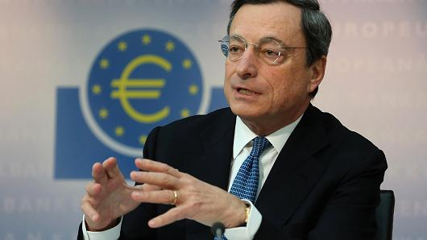
Whatever It Takes
Something had to be done, crisis was becoming
global and threatening entire Eurozone
Mario Draghi, president of ECB, July 2012 famously informed markets that the ECB would do “whatever it takes” to hold the Eurozone together - effectively pledged ECB as debt-buyer of last resort for countries in trouble
Managed to switch investor expectations from earlier fears of total insolvency to expecting some sort of recovery, borrowing costs returned to pre-crisis levels
Bailout programs also worked in some places - Ireland completed program December 2013, Spain in January 2014, Portugal May 2014

Slide 19
Are things fixed?
No.
Deep structural problems persist: high unemployment, low growth, weak banks, huge debt
Underlying causes of crisis - Eurozone monetary/fiscal power distinction means disconnect between responsibility for crises (lying with national governments) and authority to take action to address crises (lying with the ECB) still present
Still no mechanism at Eurozone level to coordinate crisis management, or even to make sure that this degree of macroeconomic divergence doesn’t happen again
Many economies still not sufficiently structurally reformed to meet Maastricht criteria
Skepticism about viability of Euro going forward → hard to predict

Slide 20
AND
Greece is still in trouble

Slide 21
Greece’s Acceptance into the Eurozone
Greece was accepted into the Eurozone in 2001 and was allowed to adopt its currency: the Euro.
To do so, they had to make many financial adjustments so as to be able to meet the Eurozone’s standards:
To enter, the applicant country’s GDP deficit was to be under 3%.
Greece stated that its deficit was less than 1% of GDP and was thus accepted into the Eurozone.
Since its admission, there have been reports that Greece’s deficit was actually greater than the 3% stipulation, and its deficit has not approached the 3% guideline since the country’s admission.

Slide 22
The Benefits of the Eurozone
With its inclusion into the Eurozone, Greece was able to borrow money at lower interest rates than it would have been able to had it not been included.
This is because of the Eurozone’s inclusion of financially credible countries, most notably Germany,
By being linked to financially stronger countries, Greece was able to give off the illusion that it was as financially stable as its compatriots and was thus able to benefit from their lower interest rates.

Slide 23
Overspending
Greece was borrowing as much as it was to feed its public sector:
The country had been through a civil war from 1945-’49, and national support for the country’s politician’s was still weak.
To secure votes, the government in power began spending huge amounts on the public sector in order to appease its people.
For example: The Greek government began offering “state-related” jobs. These jobs did not pay extremely high, but were safe in nature. These Jobs would also pay for 13 or 14 months of work during a regular 12 month period.
Due to its extremely poor tax system, Greece would pay for its spending through the massive borrowing of credit.

Slide 24
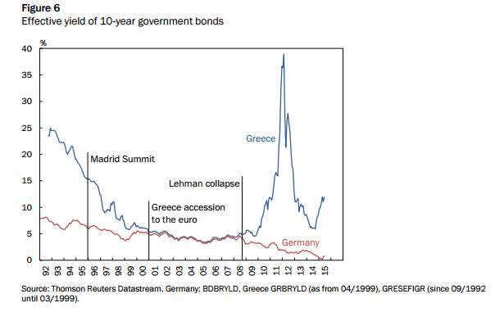
Greece was able to keep borrowing at the same rate as Germany and continued to take advantage of this equalization
We can see how different events affected Greece’s government bond rates.
With its inclusion into the Eurozone, Greece converged with Germany’s yield rates as it was seen to be reforming and would become as trusted as Germany
After the Lehman Brothers’ collapsed sparked the financial crisis, Greece’s yields skyrocketed.

Slide 25
The Meteoric Rise of Greece’s Troubles
With the financial collapse, investors no longer pretended that Greece was as financially stable as Germany:
The public credit of Greece amounts to 182% of its 2014 GDP
Greece’s GDP to debt ratio grew to 177% by late 2014
From 2008 to 2015, Greece’s Real GDP fell by 26%, and Manufactured output by 27%
Greece’s unemployment has reached 26% by 2015, up from 11% in the first quarter of 2010
Youth unemployment has skyrocketed from 20% to 50% within the same time frame

Slide 26
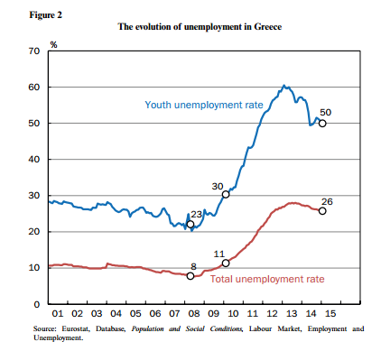
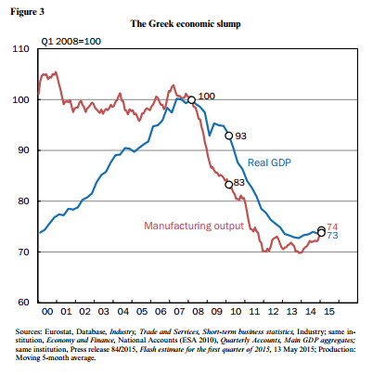
Unemployment and Greece’s Economy During the Financial Crisis

Slide 27
Where Did the Bailout Money Go?
According to former Finance minister Yanis Varoufakis, the Rescue Credit Greece did receive went almost exclusively to the private lenders who had amassed huge amounts of Greek credit.
In other words, almost all of the credit Greece received did not go towards helping out its struggling economy, but rather, the credit went to its lenders.
Its lenders being international banking institutions and private investors.
However as Sinn explains, this cannot be true based on Greece’s spending history.

Slide 28
A Very Strange Case of Dutch Disease
With all the monetary aid that Greece has received, amounting to a total of 320.4 billion Euros as of March 2015, it is puzzling as to why the country’s economy appears to be worse off than it was when the crisis started.
One explanation would be an applied case of Dutch Disease. Dutch Disease is defined as the negative impact on an economy of anything that gives rise to a sharp inflow of foreign currency. In the Dutch Case this was caused by a discovery of natural gas.
In Greece’s case, it was an abundance of debt used to maintain Greece’s social sector that led to the country’s case Dutch Disease.

Slide 29
Dutch Disease Cont.
Sinn asserts that the Rescue Credit was split 2 ways:
“Two-thirds of the public credit was thus apparently used to finance capital flight and one-third to finance the current account deficit”
The one third that was put towards the current account deficit was put towards, as Sinn puts it, the maintaining of Greek living standards.
It was this maintaining of Greek living standards that cause the country to continue borrowing and ultimately, to its lack of economical competitiveness.
To combat Dutch Disease, a cut to both the maintaining of Greece’s living standards, including a wage level cut, would go a long way to deflating prices and setting Greece back on the right track economically, as Ireland was able to do.

Slide 30
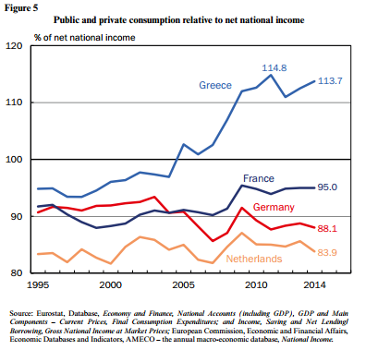
Spending Running Rampant
When the yields on Greek government bonds fell to 5%, it naturally meant that the Greek debtors had to pay less interest on their debts.
It should have followed then that this lowering of interest would have cut the Greek consumption glut.
What happened though, was that lending outgrew the savings that would have earned, and so consumption increased even more.

Slide 31
4 Tough Options For Greece (1&2)
If the other members of the Eurozone acknowledge Greece’s lack of competitiveness, they can continue financial support. This option is not attractive, however, as it would allow the Dutch Disease already prevalent to remain in place and possibly grow.
Greece might be forced into deflating its economy. While this worked for Ireland, it might prove catastrophic for Greece due to the insane amount of deflation needed would cause a high amount of Greek Debtors into bankruptcy. The debtors would not be in a position to finance their debts, leading to the mass bankruptcies. The forced wage reductions that come along with this plan would be opposed by labor unions. Ultimately, the deflation would be possible due to sheer amount of debt held by the Greek government and its citizens.

Slide 32
4 Tough Options For Greece (3&4)
3) The northern European countries could inflate. With its zero-interest policy and its policy of quantitative easing (QE) in particular, the ECB is currently trying to get inflation to rise to of 2% per year for the Eurozone average. If Southern Europe were to then adopt austerity policies to avoid inflation, and Germany inflates at a rapid rate of 4% per year for 10 years, and the crisis countries do not inflate, the adjustments to prices might be able to be achieved in 10 years.
(4) Greece could leave the Eurozone and revert back to the Drachma and then devalue its currency.The devaluation in its currency would attract foreign investors, coupled with an immediate conversion of currency and a free floating exchange rate, might be able to induce a new equilibrium in the currency market if private capital imports and exports balance.

Slide 33
Sources and Further Reading
CFR Backgrounder on Eurozone Crisis: http://www.cfr.org/eu/eurozone-crisis/p22055
VOX EU Eurozone Crisis Explanation of Consensus View of Causes and suggestions for solutions
http://www.voxeu.org/article/eurozone-crisis-consensus-view-causes-and-few-possible-solutions
“The Greek Tragedy” By Hans-Werner Sinn
“Is the Eurozone Rescue Strategy Tantamount to the Rearrangement of the Deckchairs on the Titanic?” by Miroslav N. Jovanović
http://www.tradingeconomics.com/greece

