Slide 1
Public Debt in Canada: Past, present and future Lennart Batilando and Jeff Archer

Slide 2
How do we define Public Debt?
Sum of government budget deficit and surplus over each period, the difference in government income and expenditure.
Investment in infrastructure, social services, healthcare, education
Bonds issued in foreign or domestic currency
Transfers
Interest on standing government debt
Gross Debt- Comprises both debt held by the public and intragovernmental debt; such as debt issued to various accounts of the federal government such as major trust funds in the budget.
Net Debt- Includes on the debt held by the public.

Slide 3
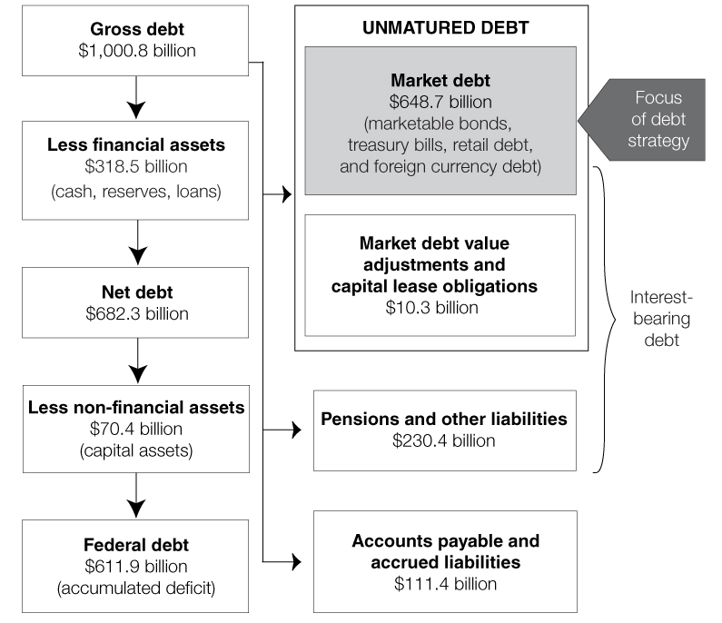

Slide 4
Is Debt a Bad Thing?
Benefits
Consequences
Allows finance of public spending without incurrence of higher taxes.
Facilitates smoothing of government expenditure over the short run.
Can allow for large growth/ purchasing power when desired.
Future taxes/ generations will need to pay it off.
As debt grows, interest payments grow.
Taxes may need to increase to pay off increased interest rates.
Distortions of economic activity.
In the case of sovereign debt, failure to pay can impact "trustworthiness" in future international transactions.

Slide 5
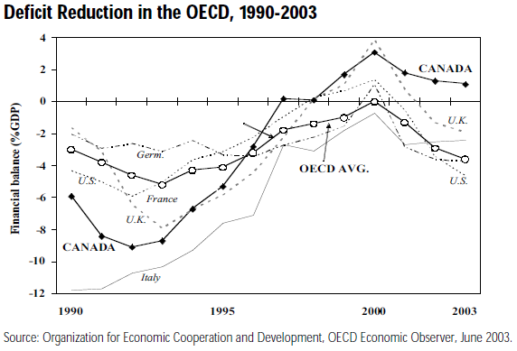
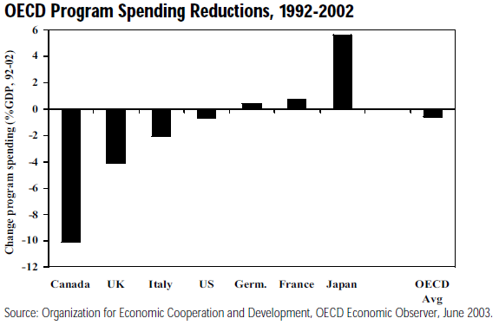
Paul Martin Era
Background
Minister of Finance 1993-2002
Prime minster 2003-2006
Motivation
Endeavoured to balance the budget as OECD governments recovered from the global recession in early 1990’s
Did so through harsh reductions of government program spending
Program spending reduced by 10% of GDP over 10 years
Surplus was achieved very quickly, faster than all other G7 nations, despite Canada’s total deficit from 1991-3 being 8% of GDP (double the OECD average)

Slide 6
Past: Brief History of Debt
2000-1
The Government’s net public debt was reduced by $17.1 billion to $547.4 billion, and it is down $35.8 billion from its peak in 1996-97.
Net public debt as a percentage of GDP dropped to 51.8 per cent in 2000-01 from a peak of 70.7 per cent in 1995-96.
In 2000-01 alone the net debt-to-GDP ratio dropped by 6.1 percentage points, the largest drop since 1948-49. This is the fifth consecutive year in which the debt-to-GDP ratio has declined, and it is at its lowest level since 1985-86.
2003-4
Federal debt was reduced to $501.5 billion, down $61.4 billion from its peak in 1996–97.
The 2003–04 budgetary surplus of $9.1 billion was used primarily to increase financial assets, which rose by $9.5 billion.
Market debt declined by $2.2 billion while obligations to pensions and other accounts increased by $2.6 billion.

Slide 7
2006-2007
$39 billion in transfers to provinces for public services and infrastructure
$2000/child tax credit
$9.2 billion in debt reduction
$550 million/year to combat the welfare trap
2009
$12 billion in new infrastructure stimulus funding for roads, bridges, broadband internet access, electronic health records, laboratories and border crossings across the country.
$20 billion in personal income tax relief
$7.8 billion to build quality housing, stimulate construction and enhance energy efficiency.
2010
$3.2 billion in personal income tax relief.
Over $4 billion in actions to create and protect jobs.
$7.7 billion in infrastructure stimulus to create jobs.
Nearly $2 billion to help create the "Economy of Tomorrow"
$2.2 billion to support industries and communities.
Fiscal spending of $1.6 billion on unemployment benefits and $1 billion in new skills and training programs.^{[4]}
Youth-related spending of $108-million

Slide 8
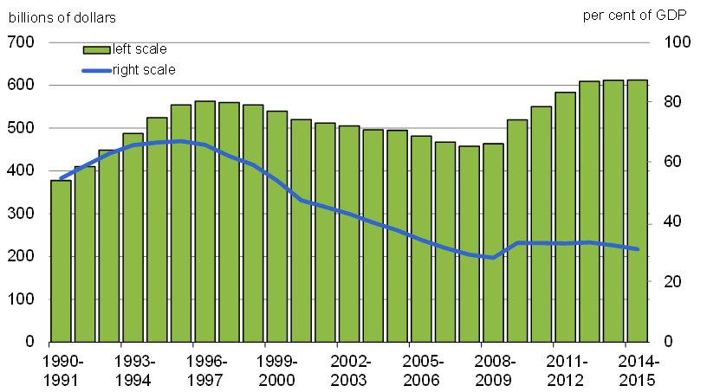
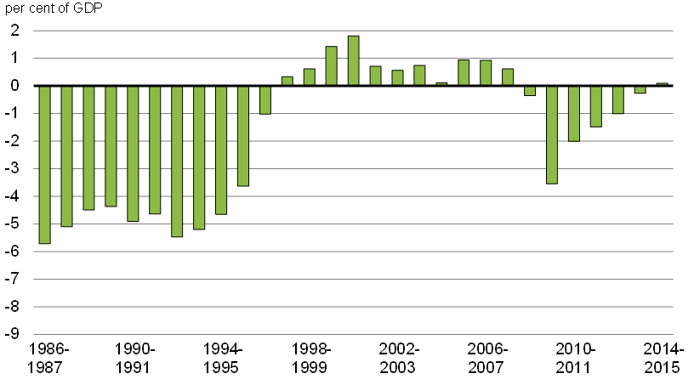

Slide 9
2008 Financial Crisis
Introduction:
Was it as severe as at first glance?
Credit bubble burst Liquidity crisis Solvency crisis Fall of Lehman Brothers
Not at center of crisis, however bulk of economic activity with U.S.
Weaker financial market could decrease foreign investment due to a lack of confidence and high levels of uncertainty.
Phase 1:
GDP declined by 3.3% over 3 quarters, compared to 2.2 and 1.9 in the 80s and 90s. Large drop in exports- 16%, compared to 8% in the 80s and 90s.
Drop of 22% in investments over 3 quarters, compared to 2 and 3 years in the 80s and 90s.
Similar but less severe to affect on US

Slide 10
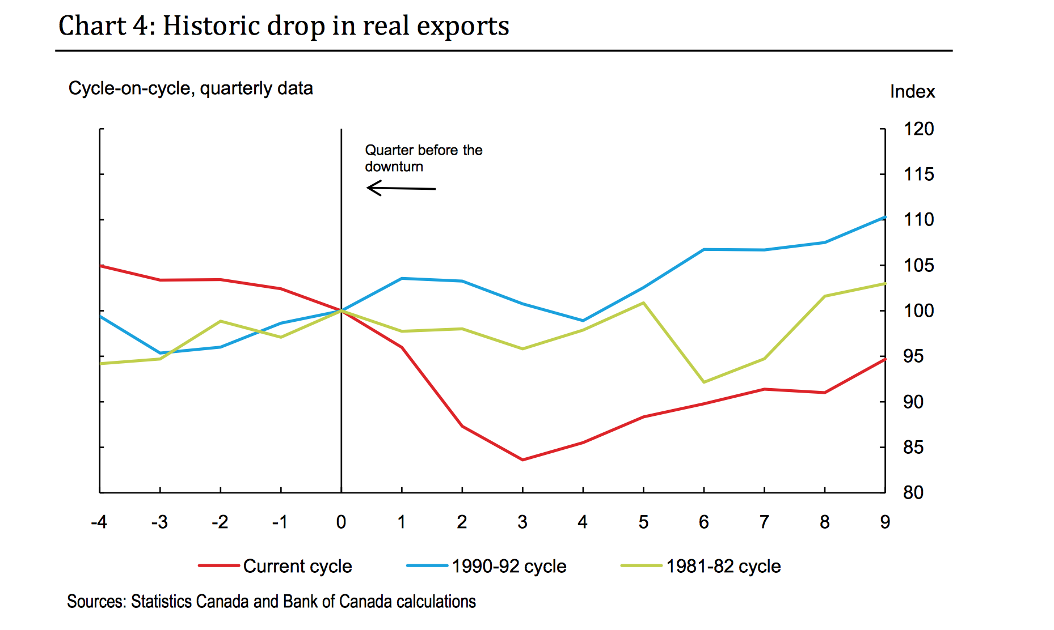
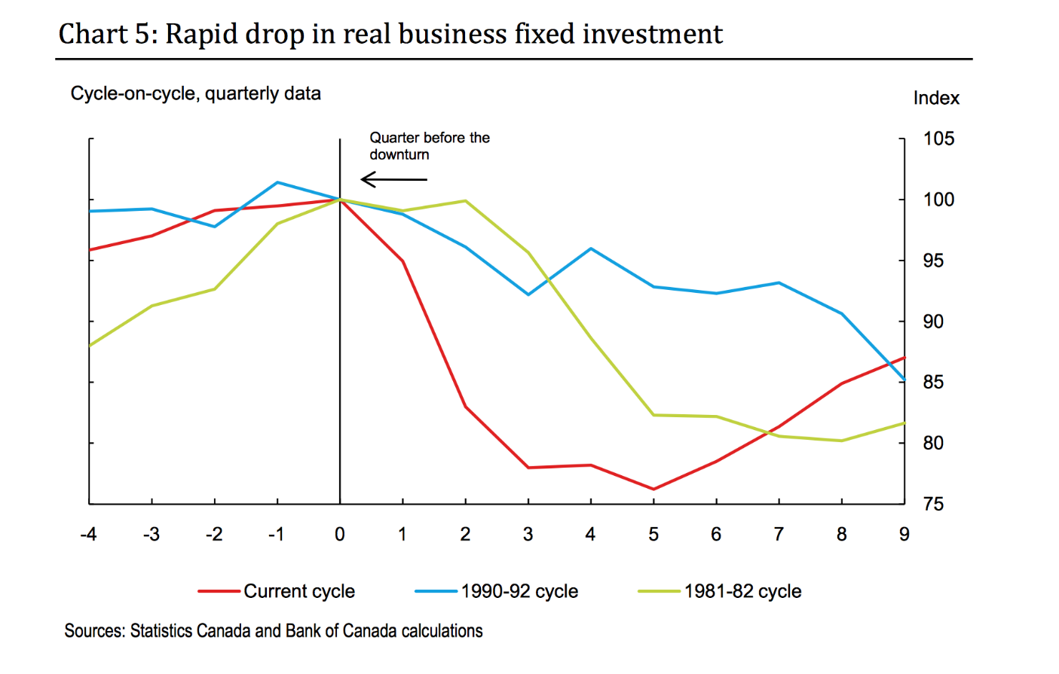

Slide 11
Phase 2:
Although GDP recovered quickly, neither business investment or exports had returned to pre recession levels.
Q: So what caused the recovery?
A: Household and government spending bolstered by domestic demand.
Lingering Issues:
Household indebtedness, international competitiveness, productivity and investment
Need to start innovating, investing, producing and exporting.
Key to survival in the crisis was “room to maneuver”.
- 2008 crisis led the Ontario government to form a 4 person commission led by Don Drummond

Slide 12
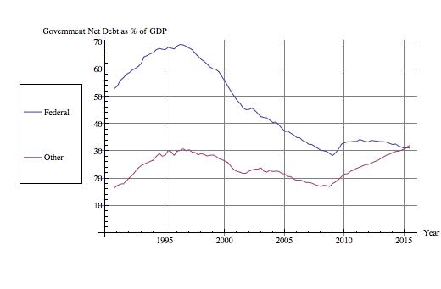
Martin Era
Financial Crisis
Federal and other levels of government Net Debt from 1990 to 2015. Raw data from Statistics Canada.

Slide 13
The Drummond Report
Summary
$14B deficit in 2010-11, Net debt of $214.5B
2011 Ontario budget set 2017-18 as the year to balance the budget
Commission led by Don Drummond created to meet/ accelerate the goal
Drummond report predicts a $30B deficit in 2017-18 on the current budgetary plan
Recommended
• Health care — plus 2.5 per cent;
• Education — plus 1.0 per cent;
• Post-secondary education (excluding training) — plus 1.5 per cent;
• Social programs — plus 0.5 per cent; and
• All other programs — minus 2.4 per cent.

Slide 14
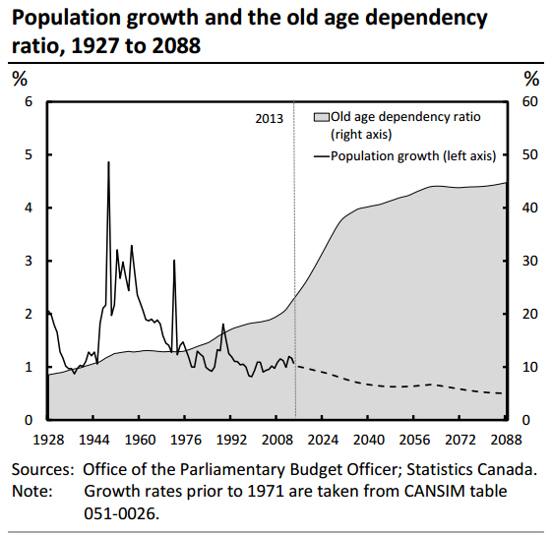
The Fiscal Sustainability Report
Projections of the future
Canada’s demographic challenge
A decreasing birth rate and increasing life expectancy will cause the old age dependency rate to increase significantly
This is expected to lead to a slower growth in the labour force and total hours worked. PBO projects average annual real growth in GDP will be 1.5% from 2019 to 2088 down from the average 2.6% over the past 30 years

Slide 15
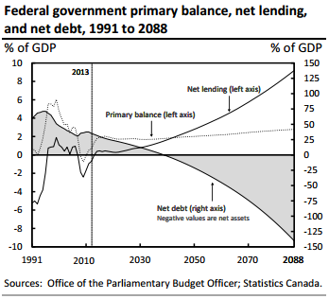
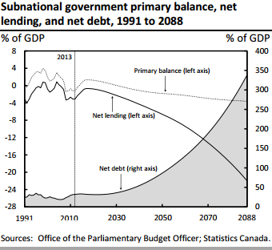
Sustainability of Canada’s debt
The PBO (Parliamentary Budget Officer) estimates that the federal government does not have a fiscal gap.
The federal government’s net debt was 35.1 per cent of GDP at the end of 2013. It is projected to decline over the projection, reaching a net asset position in 2040
The PBO estimates that Canada’s aggregate subnational governments have a fiscal gap. Under current policy their debt is not sustainable.

Slide 16
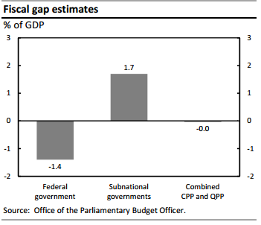
Possible scenarios of the fiscal gap
The federal government has sustainable debt under separate alternative scenarios of older demographics, slower GDP growth, higher interest rates, higher enrichment of elderly benefits, and a CHT escalator indexed to cost increases associated with population ageing.
Subnational governments will continue to have unsustainable debt under the best case alternative scenarios. Even if growth in health care costs is contained to population ageing and income growth, subnational governments will have a fiscal gap of 0.9% of GDP. If growth in health care costs can’t be reduced, provinces will have a fiscal gap of 2.5% of GDP.

Slide 17
If the provincial governments can control excess cost growth and the impact of the older population is shared proportionally between the federal and provincial governments through changes to the CHT escalator, the subnational government fiscal gap is reduced from 1.7% of GDP to 0.6%. The federal government also remains sustainable with fiscal room of 1.1% of GDP.

Slide 18
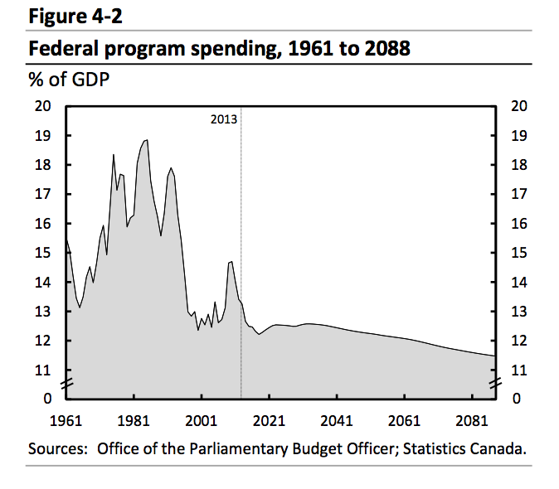
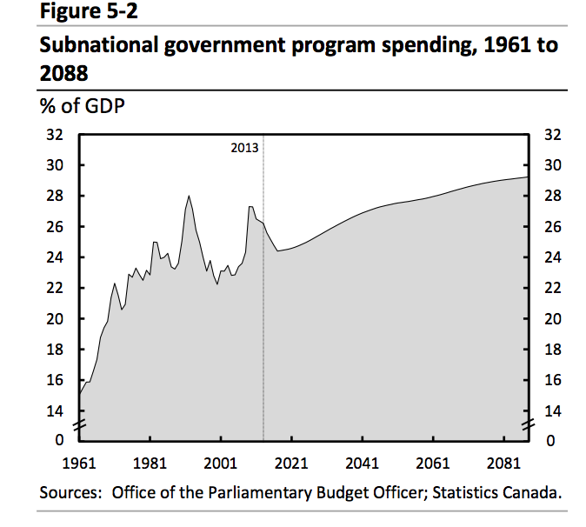
Federal spending expected to decline through direct restraint
Increase due to elderly benefits from aging baby-boomers (2018-2032)
Decline as baby-boomers move past life expectancy
Subnational expected to decline as deficit-eliminating policy announced
Growth through 2088 due to health spending

