Slide 1
Can a Central Bank go bankrupt?
Benjamin Swan and Matt Markic
ECON 421

Slide 2
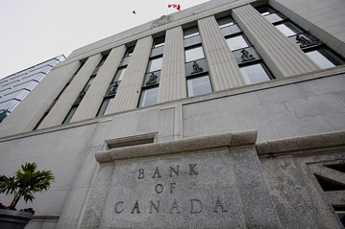
Central Banks
No bankruptcy procedure for a central bank
The central bank is able to print money
Insolvency - Central bank uses more resources than they have
Central banks can become insolvent

Slide 3
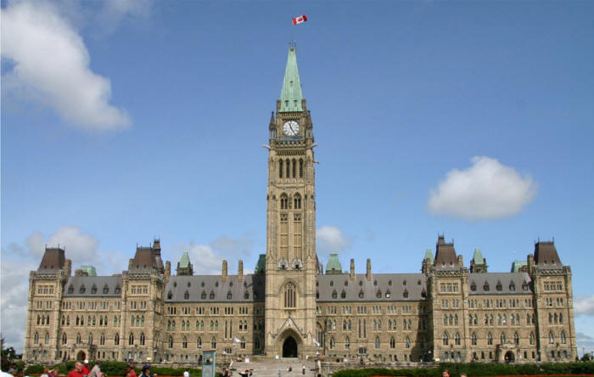
Fiscal Support
Central bank and government are intimately linked
Central bank relies upon transfers from the treasury
Fiscal Backing - Having policy to help in the pursuit of the inflation target

Slide 4
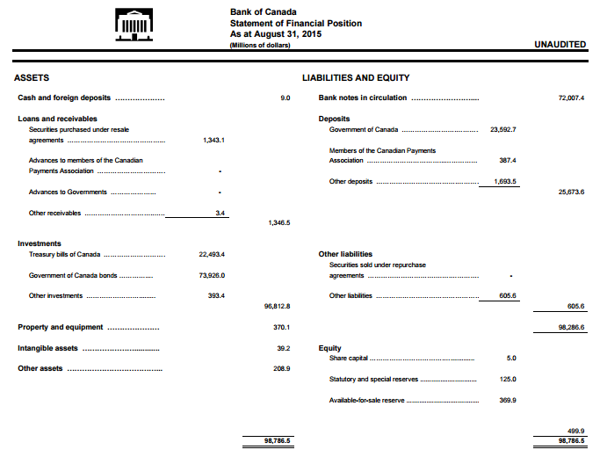
Balance sheet
W = D + L + R - M - O
“Equity is the sum of sovereign debt, private debt (collateral), and foreign currency reserves less the money stock and debt owed”
W* >= 0
W* = W + S - E - T
W + S >= E + T
S = iM
Notes:
W* is the solvency condition in accounting terms
equity + seignorage = expenses + payments to treasury
expenses are just salaries, operating costs
the present discounted value of seigniorage is the money stock multiplied by the nominal value of inflation

Slide 5
Why It Doesn’t Tell the Whole Story
Ease of incurring liabilities (seignorage)
Timeliness
is solvency conditional on CB fulfilling its obligations on time? on currency denomination of holdings?
Sovereign interest payments
at the end of the year, CB pays the treasury back anyway, net zero transaction.
“taxing” present value of currency
is this the CBs biggest risk?
Notes:
as long as the CB has a monopoly on issuing currency it can drastically increase the size of its balance sheet
the balance sheet does give a clue as to the asset portfolio, but currency risk is an issue
with sovereign interest payments, it’s important to note that a treasury payment to the fed doesn’t represent a welfare gain or loss because the fed is required to repay anyway. The fed can literally shred the note.

Slide 6
Preventing Insolvency
Central banks can recapitalize themselves if
They don’t have a lot of foreign denominated liabilities
Liabilities are in nominal terms
It’s safer for the central bank to have an injection of capital

Slide 7
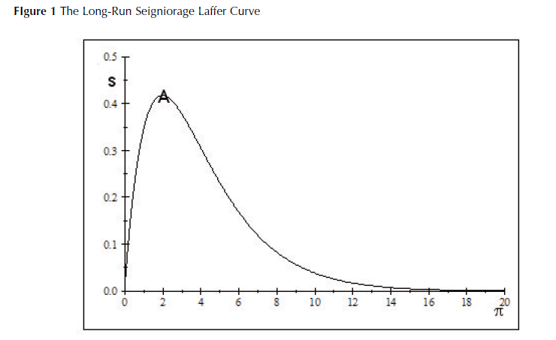
Laffer Curve

Slide 8
When Can a CB Become Insolvent?
Failure to pay obligations as they fall due (equitable insolvency)
Too much foreign-currency denominated liabilities
Without full fiscal support
Period insolvency
Rule insolvency
Intertemporal insolvency

Slide 9
Period Insolvency
The treasury demands to be paid during a year with a net loss
Central bank becomes insolvent during the first year of negative income
Possible with new-style central banking

Slide 10
Rule Insolvency
If the bank can’t pay dividends without its reserves exploding
The Fed has a special rule
Allowed to create a deferred account
Negative net income recorded in account
Doesn’t have to pay the treasury until the account balance is 0
Two quantifiable measures of bank solvency
Balance in the deferred account
The number of expected years for the balance to become 0

Slide 11
Intertemporal Insolvency
If the present value of its dividends to the Treasury is negative
There may be periods of negative net income but remain intertemporally solvent

Slide 12
How it plays out...
Zimbabwe
Iceland
US Fed
NCBs in the Euro area
what happens when the CB in Spain has to be the Lender of Last Resort for a bank incorporated in Italy?
Notes:
Good to illustrate with examples...
Zimbabwe
No credibility in monetary policy. Treating reserves like a Ponzi scheme leads to hyperinflation and an essentially worthless currency. Represents the right end tail of the Laffer curve
Iceland
Holds almost no Iceland government bonds and purchases private securities for OMT purposes. Large amount of short term foreign currency liabilities vs. assets, large holdings of illiquid long term assets, and limited access to foreign-denominated reserves puts the CB in a bad position to be LOLR even if solvency looks good in normal times.
US Fed
Massive expansion of balance sheet
Housed toxic assets, controversy surrounding whether they’d default.
Fed must incur excess reserves to pay off immediate obligations
Multiple round of QE to lower bond yields, inject liquidity, “market-maker of last resort”
EU
Who is responsible for foreign incorporated banks?
The ECB is owned by NCBs, with bigger nations holding a bigger share
According to De Grauwe, the ECB would extend liquidity to recapitalize the NCB, who would bail out the bank.
The NCB would collect interest on bailout repayments and pay it to the ECB, who would then distribute it proportionally to shareholders, e.g. Germany would profit
But this begs the question of what governing body could recapitalize the ECB? Its budget is clearly too small, burden passed on to German taxpayers? Cohen-Setton says no, it would just be an accounting transfer

Slide 13
Conclusion
Institutional/political structure
CB will fail when reserves are treated like a ponzi scheme

