Slide 1
Central Banks
Simon Friedli
Andrew Mansfield
October 6, 2015

Slide 2
Agenda
Introduction
Comparison to a commercial bank
Bank of Canada vs. Federal Reserve
Balance Sheet
Conclusion
Brief introduction to the central banks
History
How does a central bank’s balance sheet differ to a company’s BS?
What’s difference between the two biggest central banks in North America?
Banker’s bank
Government’s bank
Regulator and supervisor
We are all part of the Federal Reserve’s balance sheet
Sometimes I think the Central Bank will keep printing money till we run out of trees.
- Jim Rogers
Introduction
Comparison
Two Central Banks
Balance Sheet
Conclusion
2

Slide 3
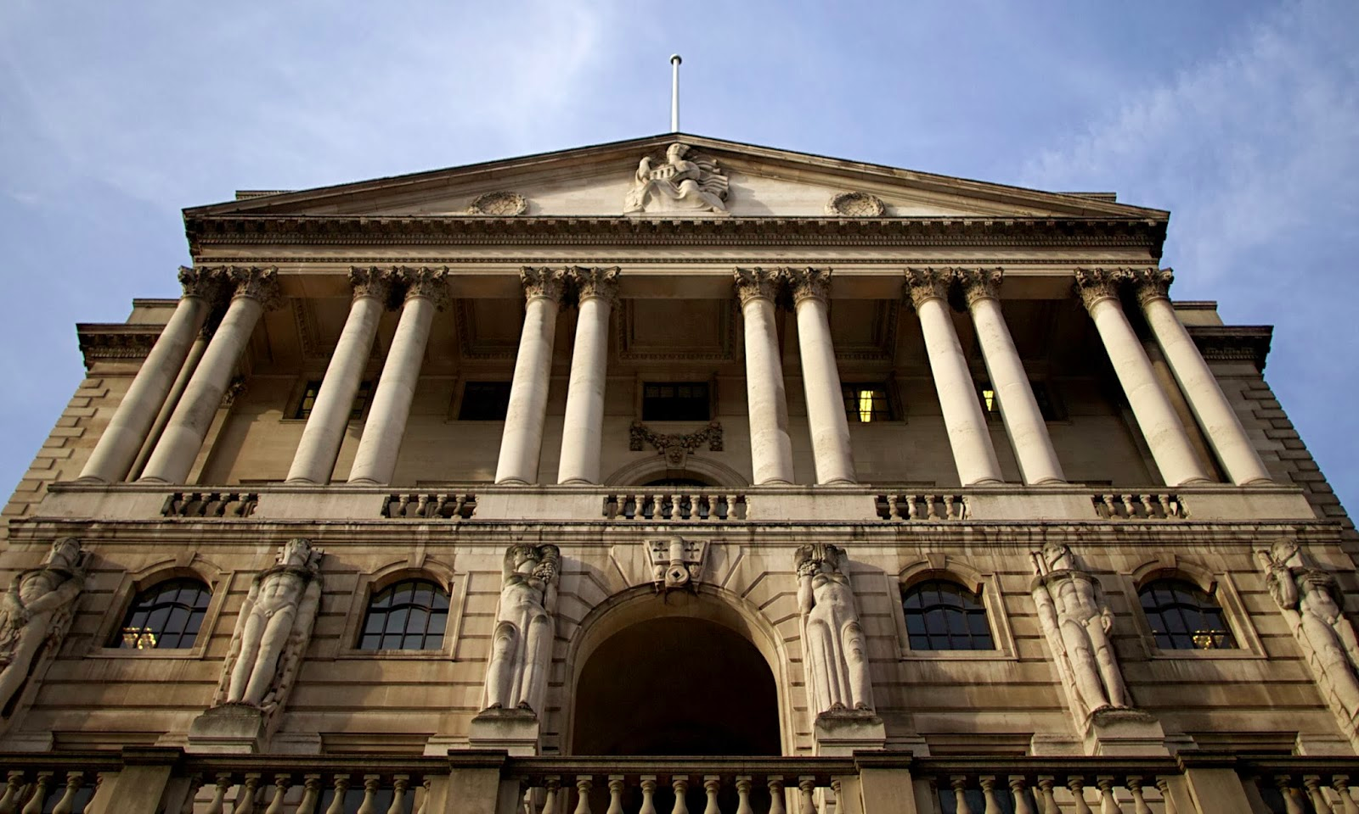
Introduction: History
The begin of an Era
In the 1900s, there were only 18 central banks
Oldest central bank was established 1694
Federal Reserve and European Central Bank were central banks right from the start
Introduction
Comparison
Two Central Banks
Balance Sheet
Conclusion
3

Slide 4
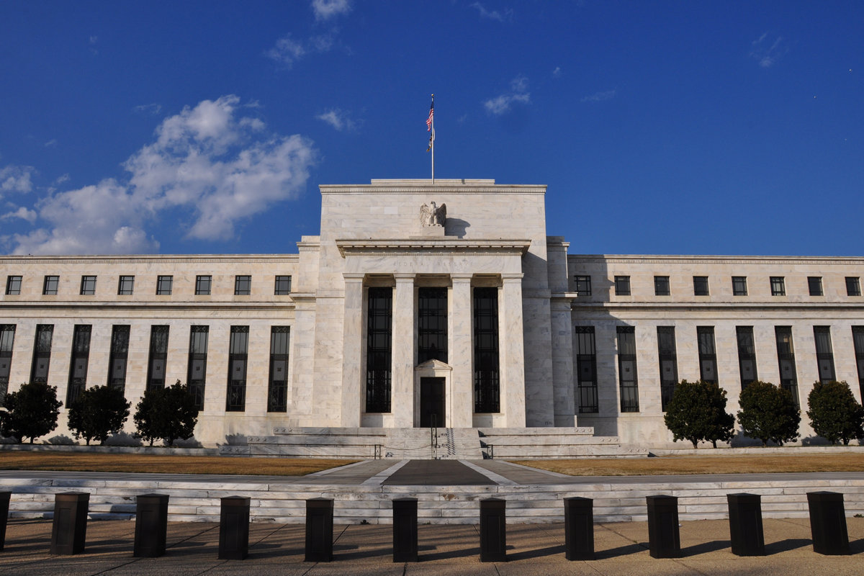
Introduction: A Brief Overview
Characteristics & Duties
Maintain macroeconomic and financial stability
Tools:
Open Market Operations
Discount Rate
Reserve Requirements
The Federal Reserve sets the target for the interest rate in open market transactions
Introduction
Comparison
Two Central Banks
Balance Sheet
Conclusion
4

Slide 5
Comparison: With Commercial Banks
Central Bank
Commercial Banks
1
Reserves
Holds numerous forms of reserves, including foreign currency and gold. Commercial Bank reserves are classified as a liability.
Hold reserves in house to meet ratio but the rest are held within central bank vaults and is classified as an asset.
2
Profitability
Central Bank only offers a .25% interest rate on savings within the reserve
Exchanging interest-free notes for government bonds
Pay more on loan interest than receive from interest on savings
Loans end up lying within commercial banking savings accounts
3
Difference in Key Assets
US & Canada
Securities are likely the most important
China
Exports are likely the most important. (Or the power of their currency)
Introduction
Comparison
Two Central Banks
Balance Sheet
Conclusion
5
5

Slide 6
Comparison: With Non-Financial Institutions
On the Asset Side
Cash, inventory, & raw materials
vs.
Loans
Profits and Risks
Regulations:
Emergency Economic Stabilization Act
Economic Recovery Act
Comparing Business Models
Loans ARE the product
Introduction
Comparison
Two Central Banks
Balance Sheet
Conclusion
6

Slide 7
Comparison: Finding Common Ground
Bridging the Gap between Sheets
Debt vs Raw Materials
Interest Payments vs Cost of Production
Challenges of reinvestment
Introduction
Comparison
Two Central Banks
Balance Sheet
Conclusion
7
Notes:
Trade Area Per Capita Spending on General Retail Merchandise is $6,506.47

Slide 8
Federal Reserve: Quick Overview
[Simon, insert slide with competitors]
Balance Sheet | Assets | Anchors
Banker’s bank | Loans (to commercial banks) | Bank Accounts (reserves, vault cash)
Government’s bank | Securities (Treasuries) Foreign Exchange Reserve (foreign bonds) | Currency (publicly held) Government Account (similar to a checking account)
Regulator and Supervisor
Introduction
Comparison
Two Central Banks
Balance Sheet
Conclusion
8

Slide 9
Federal Reserve: Total Assets
Federal Reserve | (in millions)
Gold / Coins | 11’037
Special drawing rights | 5’200
Securities
US. Treasuries | -
Federal Agency debt | 39’990
Mortgage-backed security | 1’789’083
Investments in foreign currencies | 20’900
Repurchase agreements | 2’596’241
 | 25’644
Central bank liquidity swaps | 1’528
Other assets | 6’278
Total Assets | 4’497’774
Introduction
Comparison
Two Central Banks
Balance Sheet
Conclusion
9

Slide 10
Federal Reserve: Total Liabilities and Total Capital
Federal Reserve | (in millions)
Liabilities
Federal Reserve notes outstanding | 1’298’725
US. Treasury account | 223’452
Reverse repurchase agreement | 509’837
Depository Institutions | 2’377’452
Other liabilities | 29’663
Capital
Capital paid-in | 28’572
Surplus | 28’572
Total Liabilities and Capital | 4’497’774
Introduction
Comparison
Two Central Banks
Balance Sheet
Conclusion
10

Slide 11
Balance Sheet: Trend Over Ten Years
Total Assets of the Federal Reserve and the Bank of Canada
Introduction
Comparison
Two Central Banks
Balance Sheet
Conclusion
11
Notes:
Trade Area Per Capita Spending on General Retail Merchandise is $6,506.47

Slide 12
Conclusion
Thank you!
Play ‘The Federator’ to find your inner Bernanke!
Introduction
Comparison
Two Central Banks
Balance Sheet
Conclusion
12

